Slide 1

BVCOG Contract Management System
Matan Broner: Product Owner
Liam Berney: Scrum Master
Chrysanthos Pepi
Hanrui Chen

Slide 2

The problem:
The Brazos Valley Council of Governments (BVCOG) needed a Contract Management System.
BVCOG sent contracts electronically to the contracts@bvcog.org email address, with very little description as to what the contract was about, who it was with, when it expired, and whether it could be renewed.
Sometimes contracts would expire without them taking the appropriate action, or they'd continue perpetually on a month-to-month basis resulting in disallowed costs.

Slide 3

Our Solution:
We've built a robust contract management system for BVCOG that can manage multiple levels of users, contracts, entities, programs, and vendors.
The system makes managing contracts easy with automated reports and expiry reminders, and keeps documents related to reports centralized and easy to maintain.
Our system can be used to:
Enter Contracts
Approve Contracts
Send Email Reports and Reminders
Generate Reports
Retrieve/Edit Contracts
Review Vendors
Invite new users

Slide 4
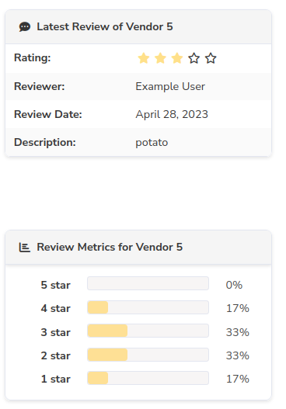
Features
An Amazon style review system for vendors; Users can review vendors based on how previous contracts went so that better vendors can be selected in the future

Slide 5
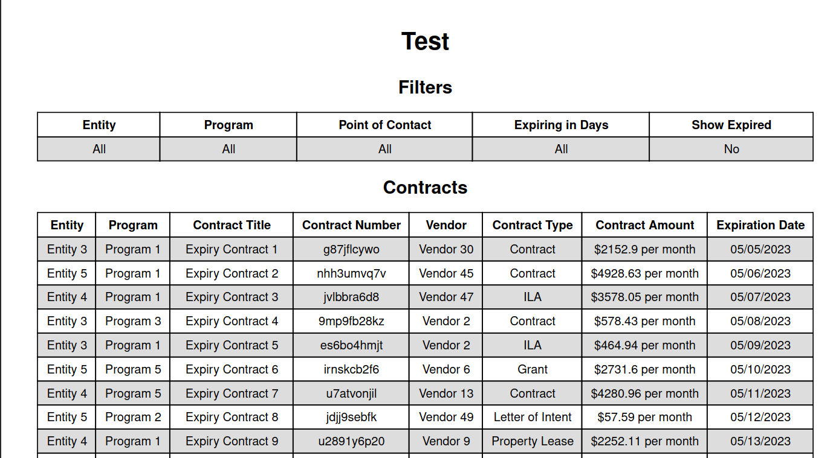
Features:
Reports generation: Highly customizable pdf reports can be generated for both users and contracts.
User reports: A list of all users, their status, and level
Contract Reports: A list of contracts filtered by program and entity, when they expire, and other relevant data

Slide 6
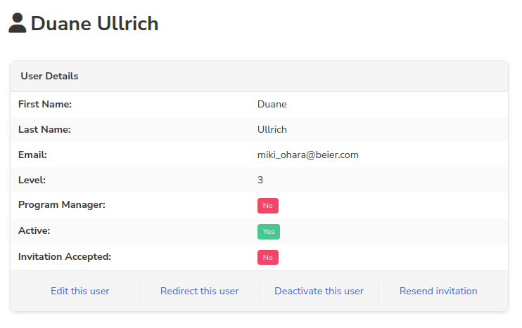
Planning for the future
We wanted to make sure our system could be used for the long term, so we thought about how inviting new users, and removing existing ones would work.
New users can be added by a level 1 or 2 user, prompting them with an email; Emails expire but can easily be re-sent, and no temporary passwords are required to get started
When users leave, their accounts can be deactivated without being deleted; Before this happens though, our system makes you redirect reports and expiry reminders to another user to ensure nothing is forgotten about. We've made sure this progress is easy and convenient.

Slide 7
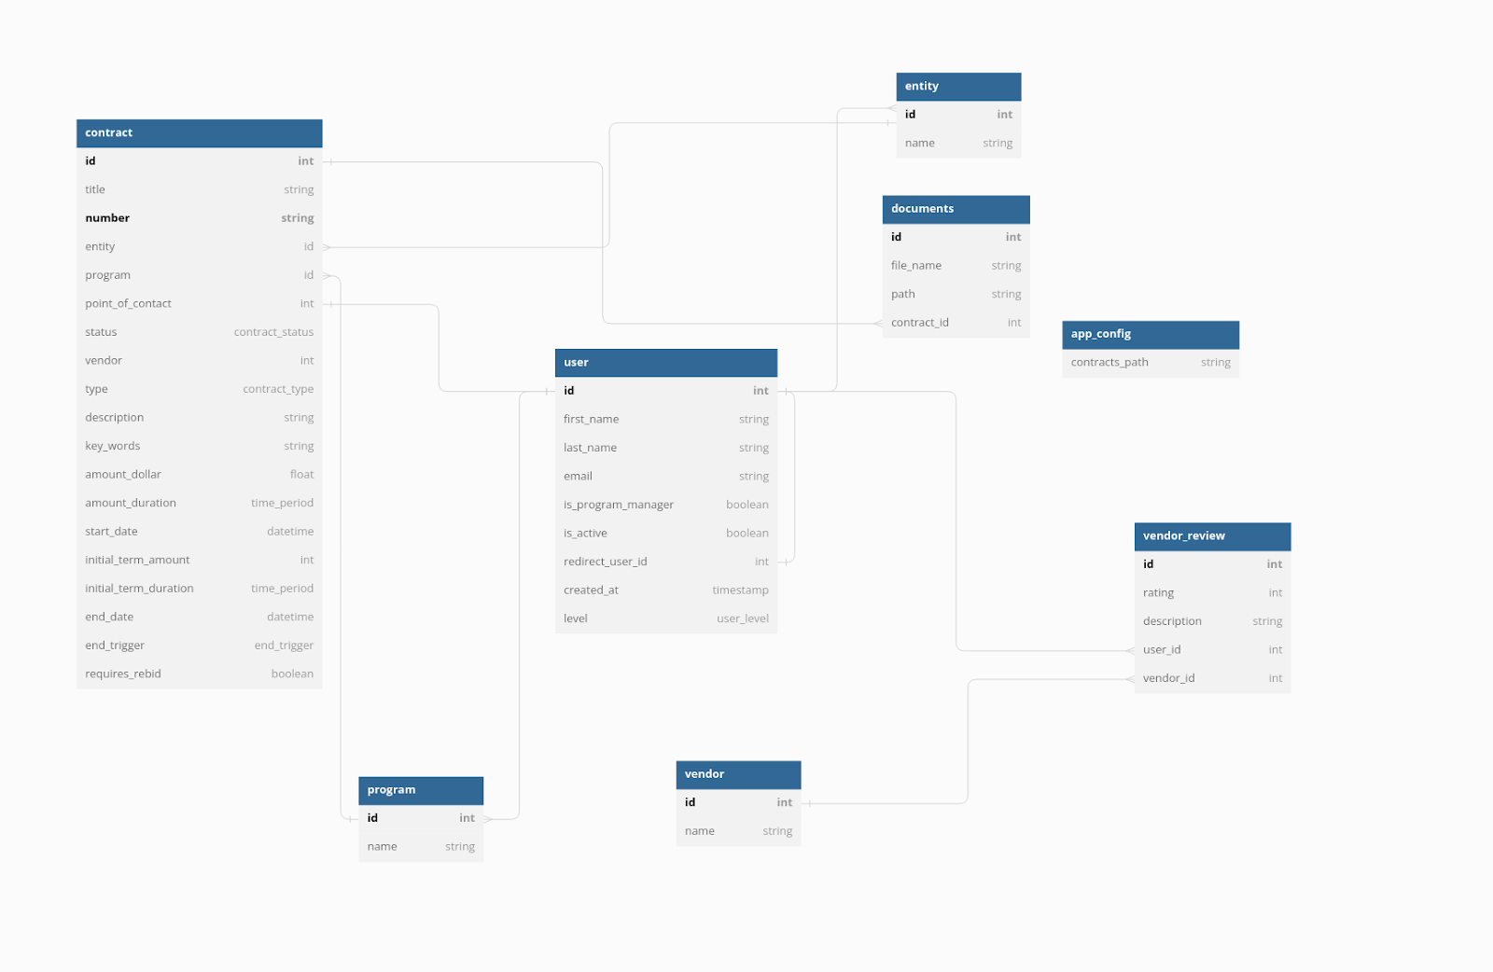
Database Design

Slide 8

Gems/Technologies used
Devise: For user authentication and password resetting
Devise_inviteable: For user invites
Kaminari: Table pagination
Bulma_rails: Styling
Polar OSO: Role based Access Control
Whenever: Automated cron jobs

Slide 9

Challenges
Our system needed to support 3 different levels of users
Level 1: Administrator
Level 2: Privileged User
Level 3: Standard User
This meant that there were multiple layers of functionality to manage, both from a technical and UI standpoint, and required including polar OSO in our project
Testing could also be difficult due to multiple layers of error handling

Slide 10
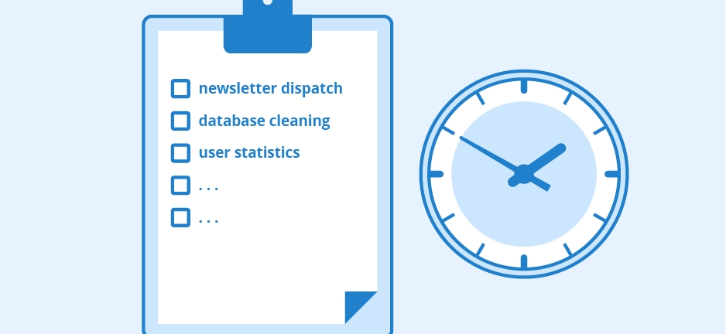
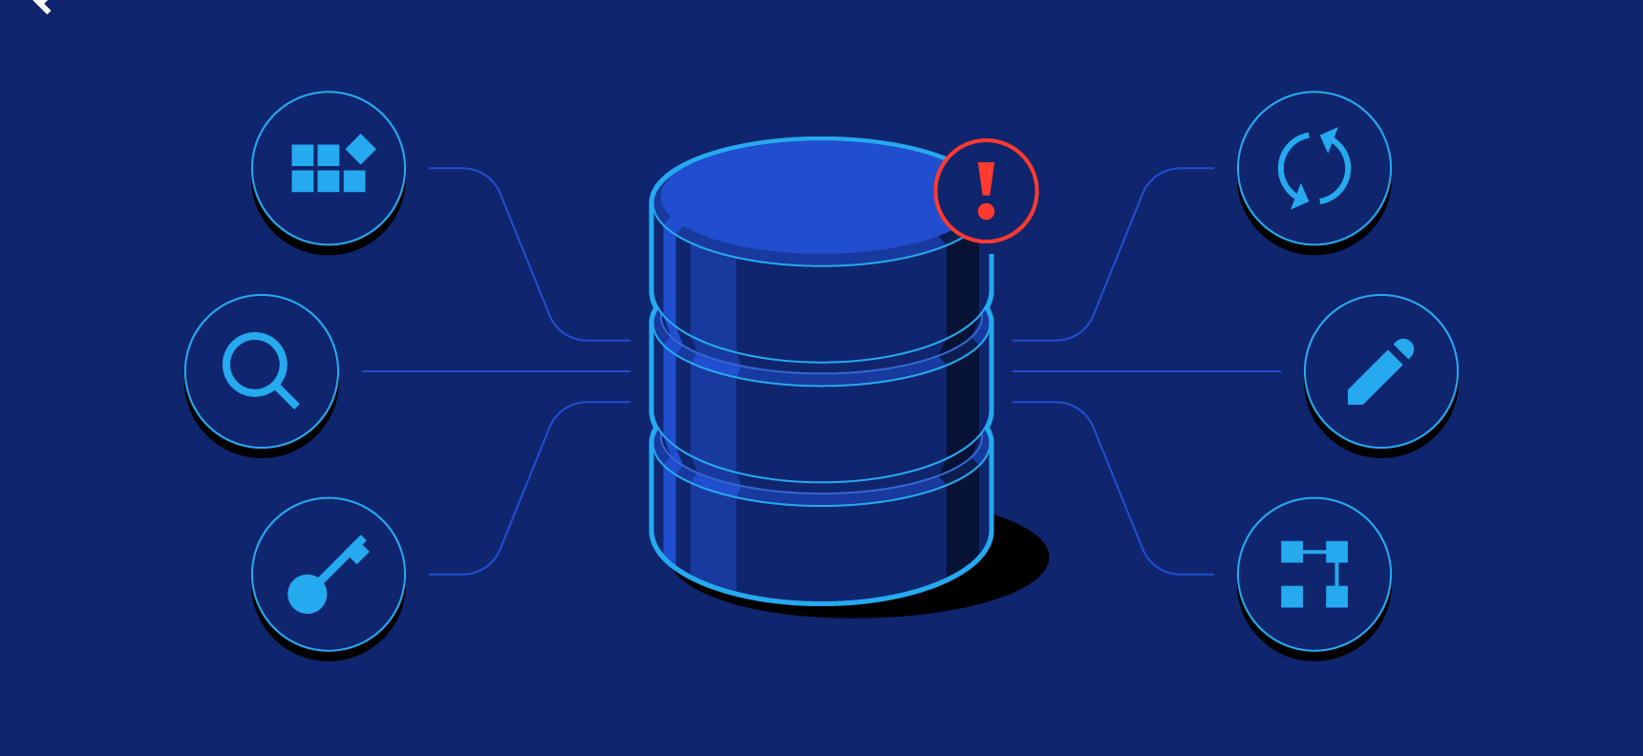
More Challenges
Our system uses Cron jobs to support daily and monthly automated reports and contract expiration reminders
These Cron jobs needed to be able to activate rake tasks that used an SMTP email server
Our database needs to be change resilient so that as features and users are added in the future, our client won't run into problems

Slide 11
Lessons learned
Communicate early with clients; Some major changes needed to be made late into the project because we didn't clarify what our users really wanted
Communicate within our team; Some work was done twice because of a lack of this
Do things the Railsy way when working with Rails; If you try to do it another way, you will forever be plunged into darkness

